Slide 1


{ Java } BluePrint.
Pramod Dutta
Jump to Core Java

Slide 2
Remove Coding FEAR! Jump to programming(1 Shot)

Slide 3
Agenda
Install Java JDK
Variables
Data Types
String Class & Casting
Operators
Arithmetic Operators
Assignment Operators
Comparison/Relational Operators
Logical Operators

Slide 4
Agenda
Math class
Taking Input
Conditional Statements ‘if-else’
Class
Object
Mini-Project Problem

Slide 5
Install Java
Install JDK
Eclipse
Set the Path Java_home.

Slide 6
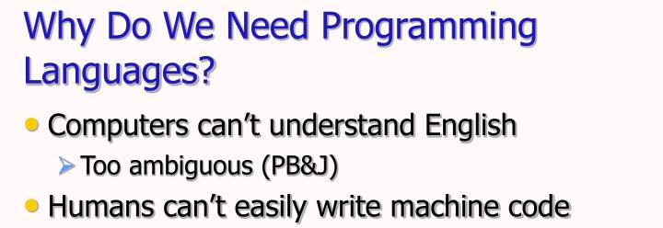

Slide 7
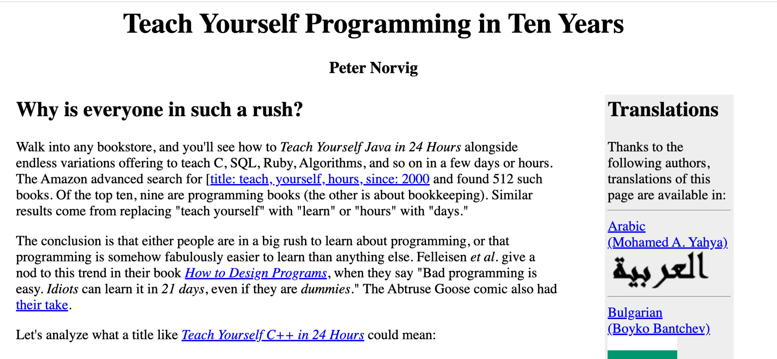
https://norvig.com/21-days.html

Slide 8
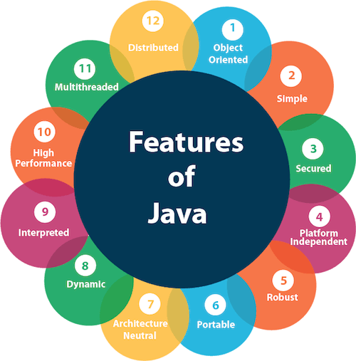
What is Java?
Java is an object oriented language.
Java is a programming language and computing platform first released by Sun Microsystems in 1995.

Slide 9
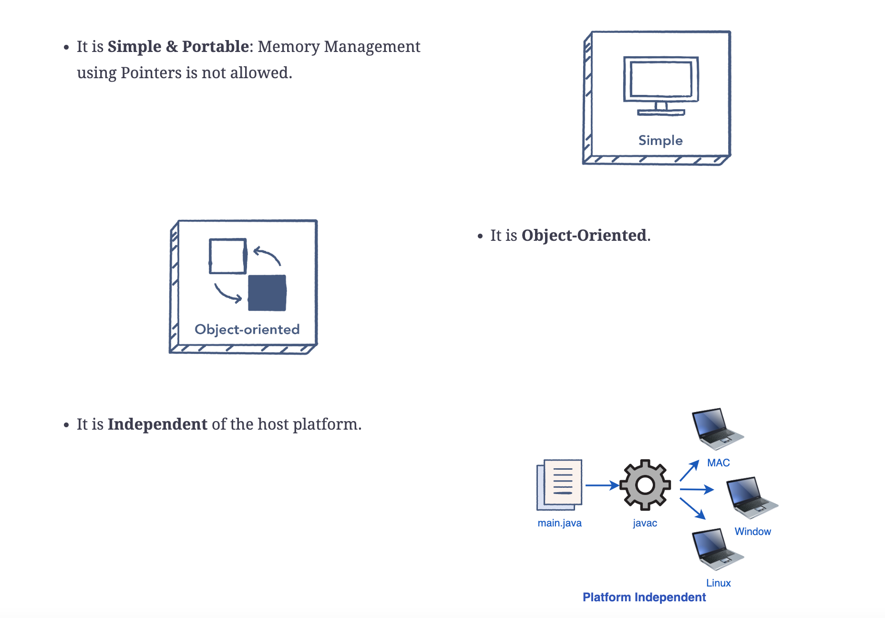
Primary goals in the creation of the Java language

Slide 10
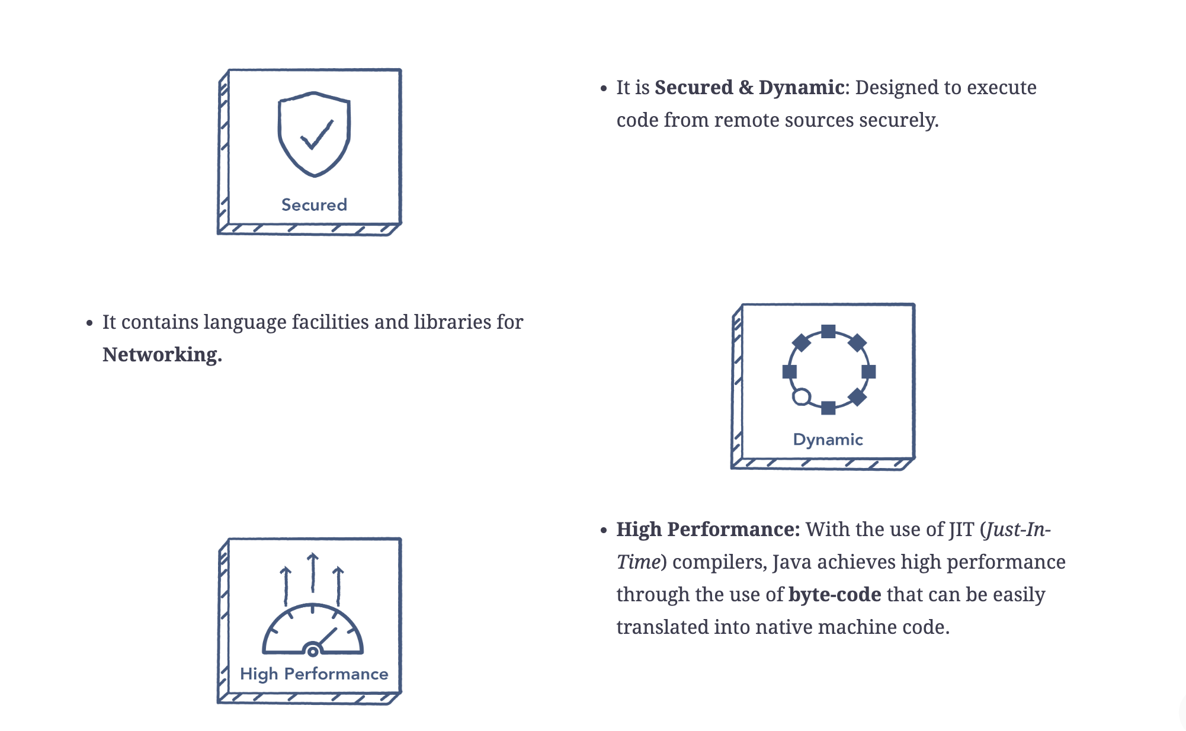
Primary goals in the creation of the Java language

Slide 11
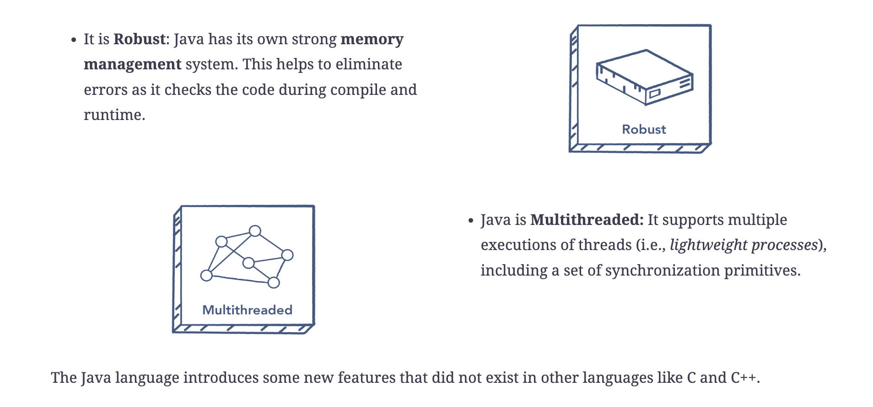
Primary goals in the creation of the Java language

Slide 12
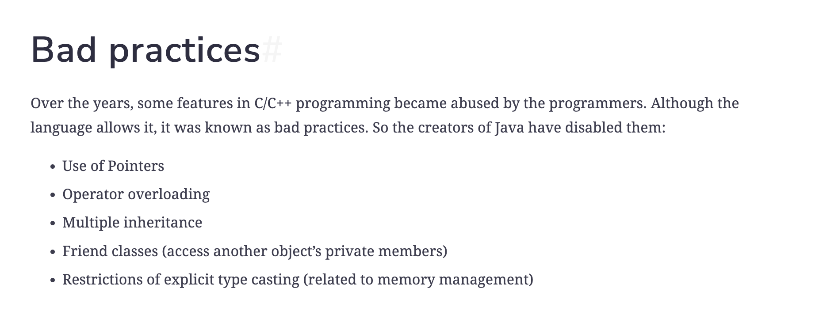
Primary goals in the creation of the Java language

Slide 13
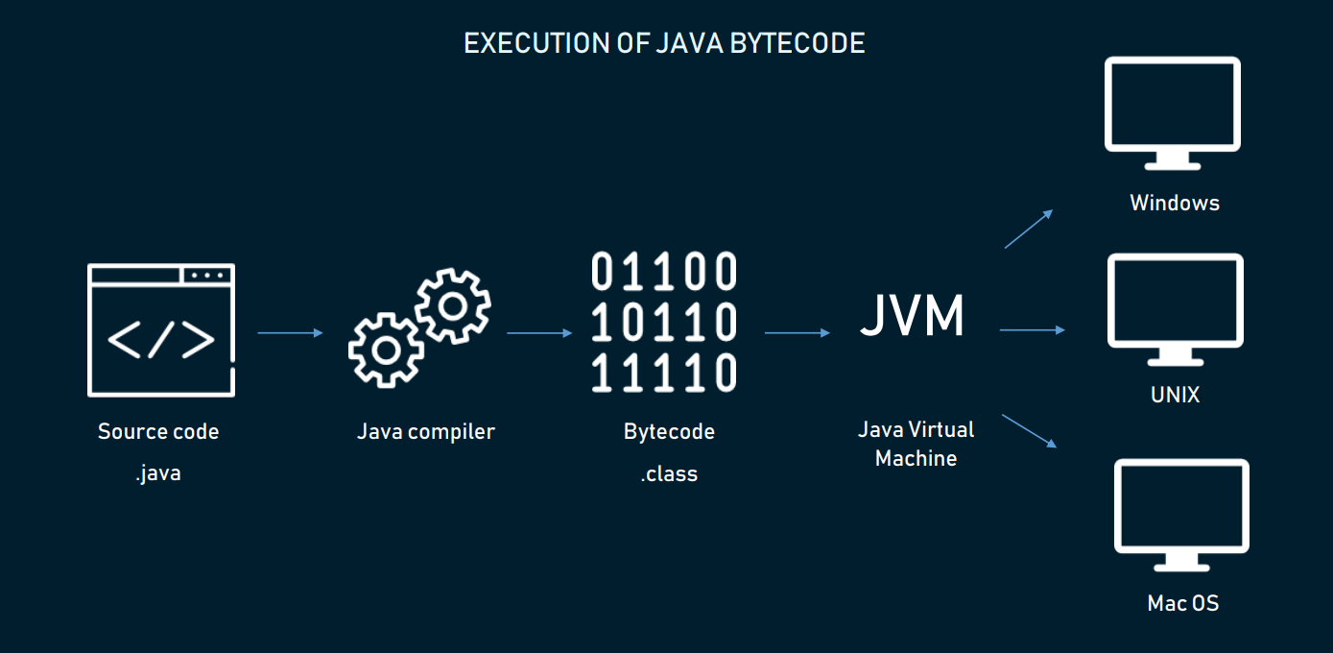
Core Funda of Java is Write once and Run anywhere!!

Slide 14
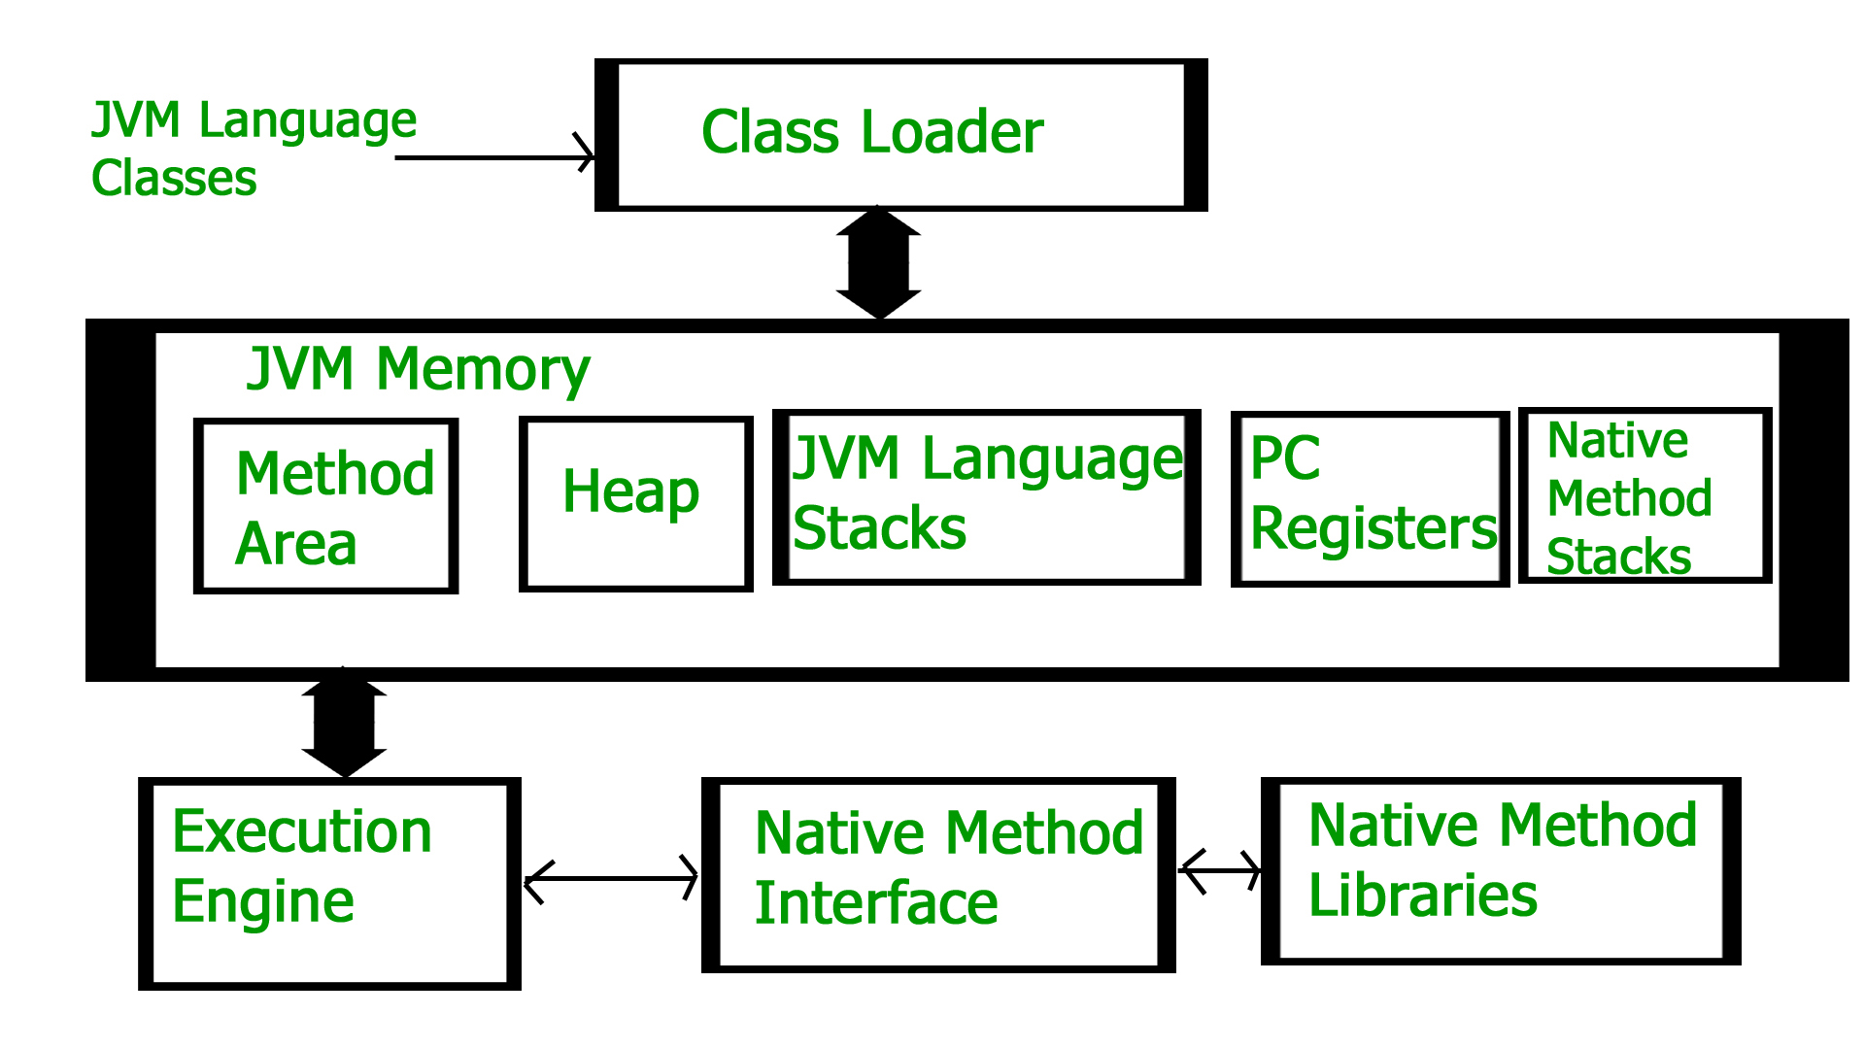
Run anywhere ?? JVM Architecture

Slide 15
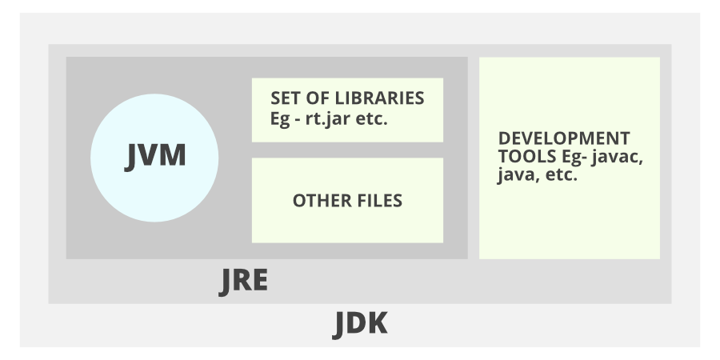
Run anywhere ?? JVM Architecture
Java Development Kit (JDK)
JRE (Java Runtime Environment)
JVM (Java Virtual Machine)

Slide 16
JDK > JRE> JVM
Java Development Kit (JDK)
used for developing Java applications
includes the Java Runtime Environment (JRE), an interpreter/loader (Java), a compiler (javac), an archiver (jar), a documentation generator (Javadoc), and other tools needed in Java development.
JRE (Java Runtime Environment)
to execute your java program
not develop
JVM (Java Virtual Machine)
JVM is responsible for executing the java program line by line, hence it is also known as an interpreter.

Slide 17
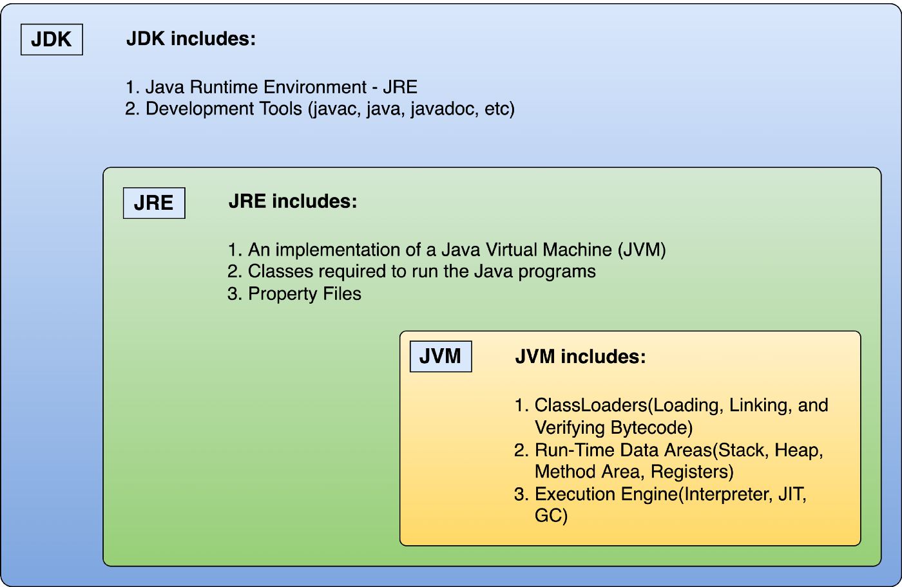
JDK > JRE> JVM

Slide 18

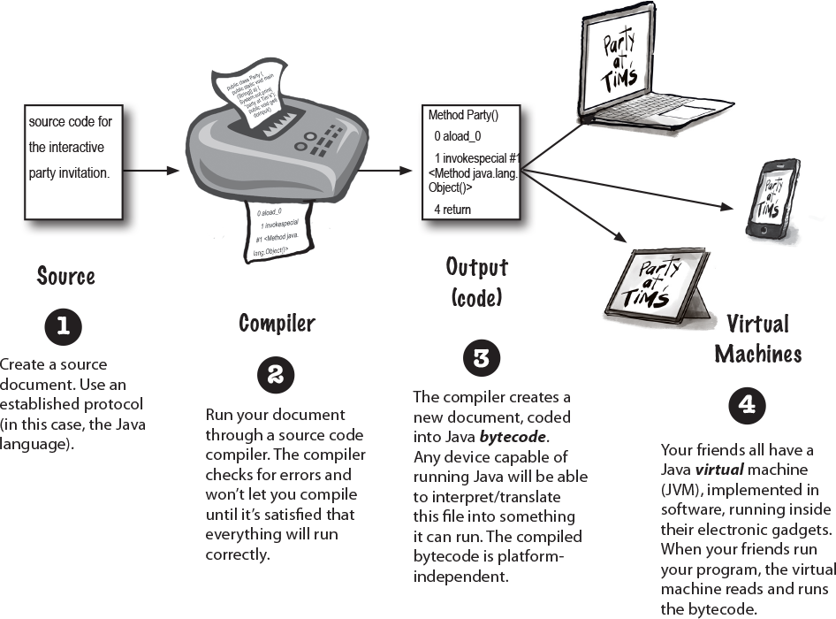
How Java Works?
401 Response

Slide 19
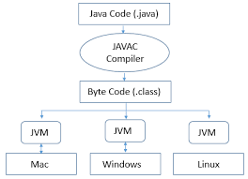
How Java Works?
Source Code -> Compile It (Javac) -> Run the Compiled Code -> JVM installed on Machines
401 Response

Slide 20
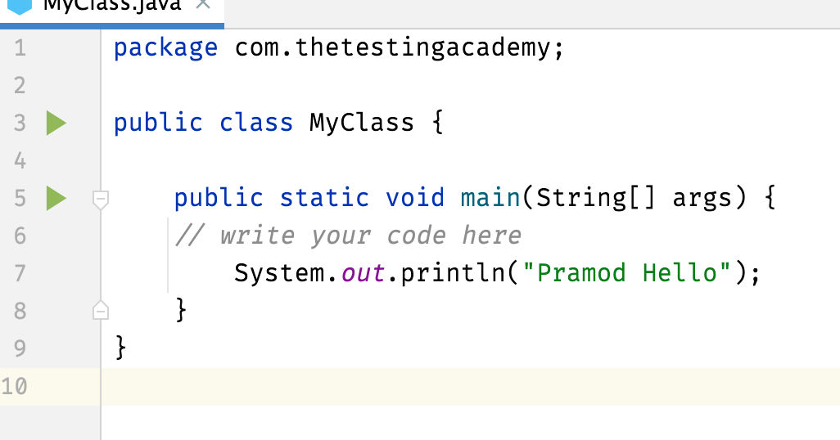
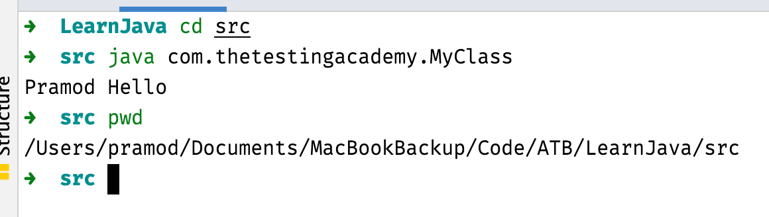
Running Java File Using CMD
filename.java
Move to src
java com.thetestingacademy.MyClass
401 Response

Slide 21
What does the compiler do?
The compiler is a translator that acts as an intermediary between the programmer and the CPU on the computer.
401 Response

Slide 22
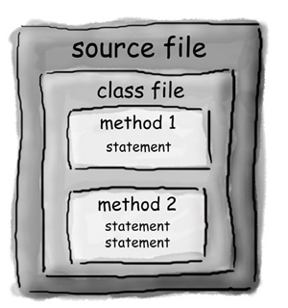
Code Structure in Java
Class Holds -> Methods -> Statements (what Methods can do)
401 Response

Slide 23
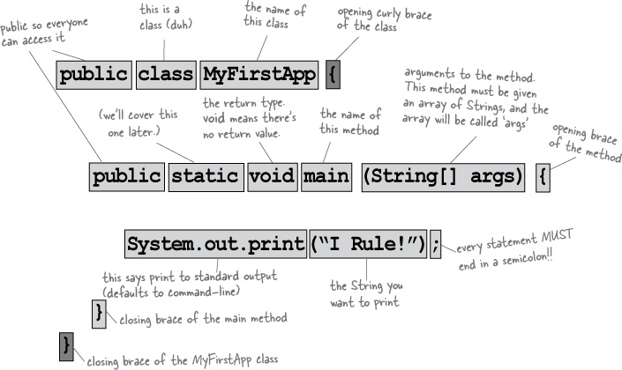
Code Structure in Java
401 Response

Slide 24
!Important
Every line that needs to be executed should be inside a class.
Declarations and definitions
class HelloWorld is the class declaration.
The main is the point from where all the Java programs start its execution.
Just as sentences in English must be terminated with a period.
Just as sentences in English can span several lines, so can the statements in Java.
401 Response

Slide 25
Doubts
Do I have to put Main() Method in every class to run?
No, We can have multiple classes in Java, to run we need only one main method
401 Response

Slide 26
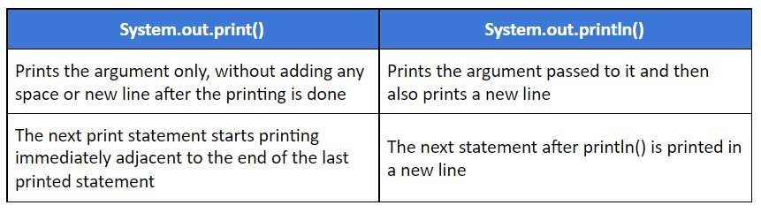
!Important
Did you know? The System.out.println() displays text in the current line of the console and then move the cursor to the beginning of the next line.
401 Response

Slide 27
Quiz
Can we execute a java program without a main method?
401 Response

Slide 28
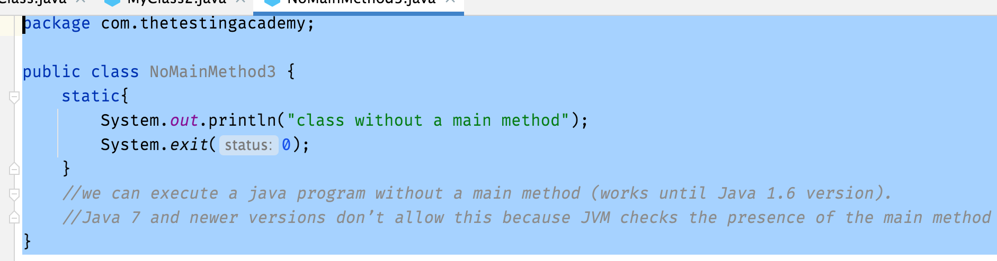
Quiz
Can we execute a java program without a main method?
https://stackoverflow.com/questions/15173474/can-we-execute-a-java-program-without-a-main-method
Yes, we can execute a java program without a main method by using a static block
401 Response

Slide 29
What you can Say in Main Method?
Do something
Do Some Things Again and Again
Do some under this condition
Loop and Loop Again
401 Response

Slide 30
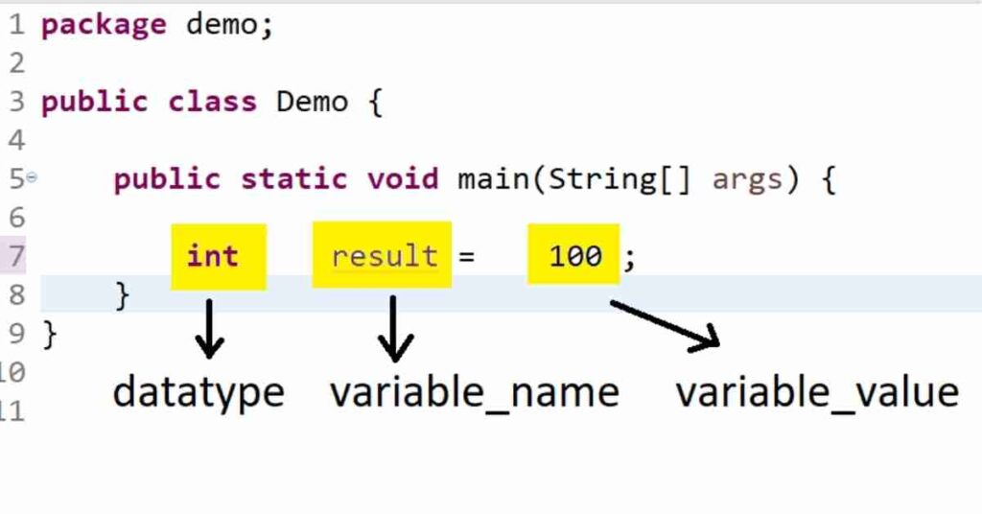
Variables
A variable is a container (storage area) used to hold data.
Each variable should be given a unique name (identifier).
401 Response

Slide 31
Variables
A variable is a storage location paired with an associated symbolic name (an identifier), which contains some known or unknown quantity of information referred to as a value.
Variables in Java are strongly typed; thus they all must have a data type declared with their identifier
There are three rules to create an identifier:
Characters from A to Z, as well as their lowercase counterparts, can be used.
Numbers from 0-9 can be used.
Special characters that can be used are $ (the dollar sign) and _ (underscore).
401 Response

Slide 32
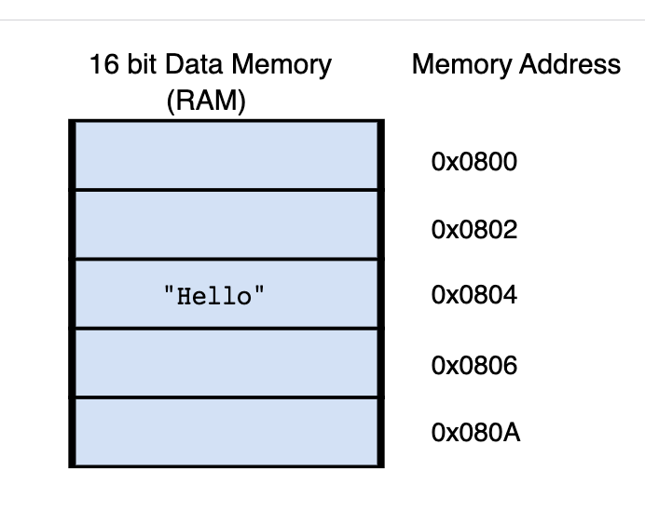
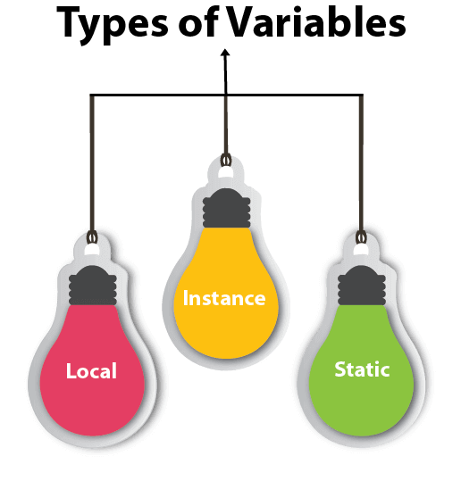
Where are the variables stored?
Variables, once declared in the program, are allocated space in memory.
Memory itself is organized as a long collection of one byte after another.
401 Response

Slide 33
Variables
local variable
instance variable
static variable
401 Response

Slide 34
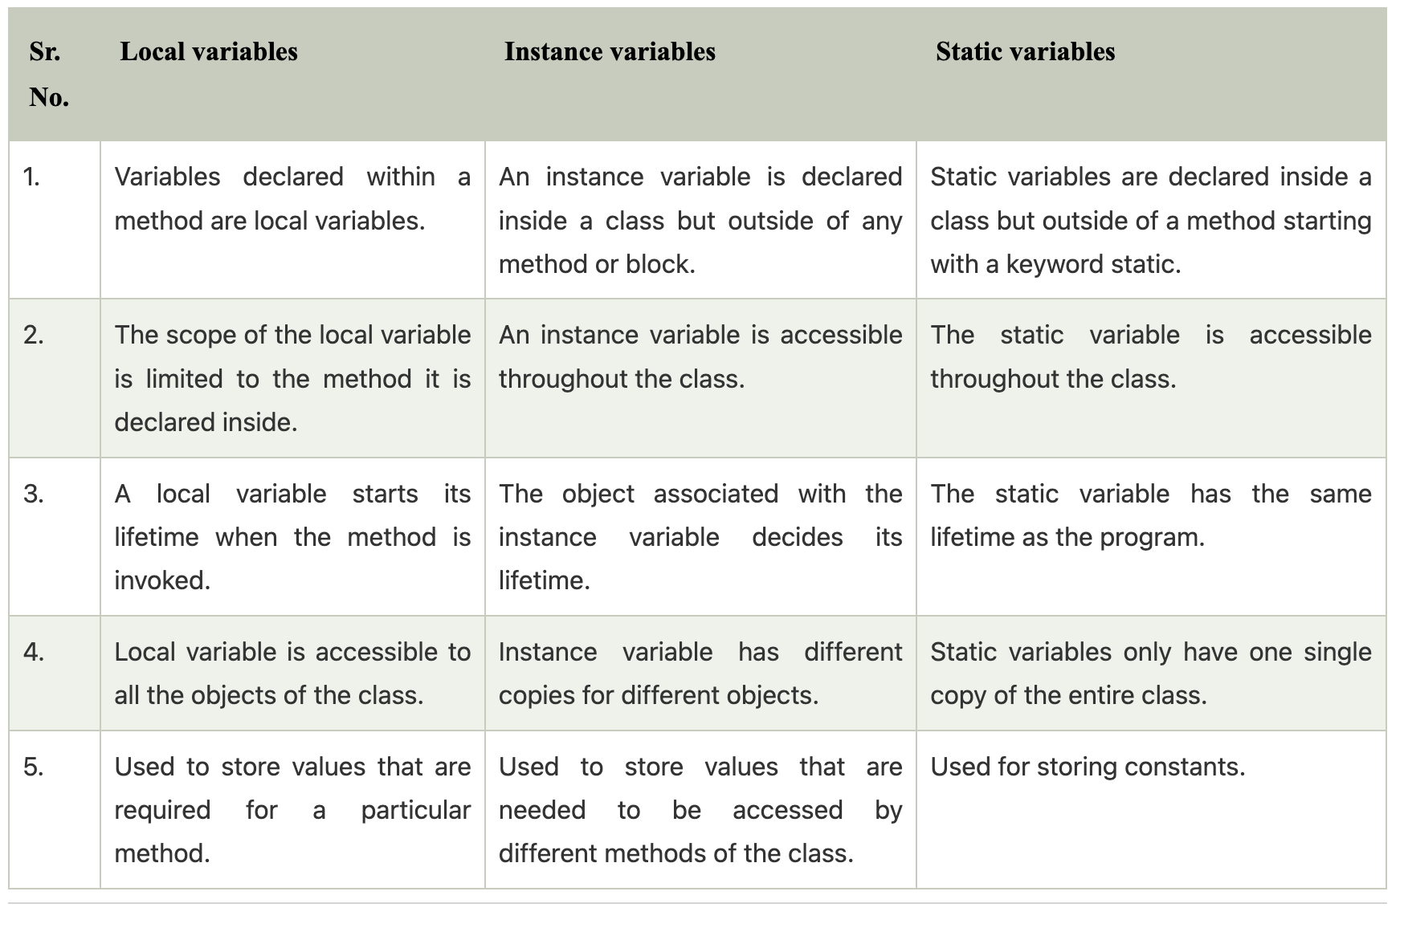
Variables
401 Response

Slide 35
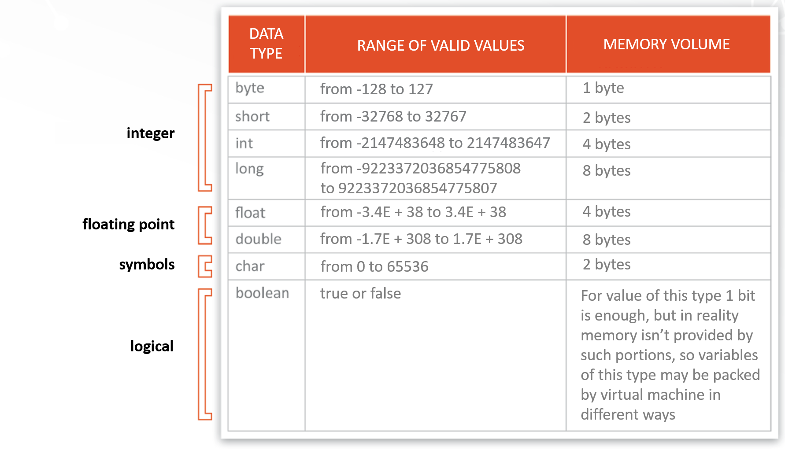
Data Types
Data types are declarations for variables
There are 2 types of Data Types :
Primitive Data types : to store simple values
These are the data types of fixed size.
401 Response

Slide 36
Data Types
Non-Primitive Data types : to store complex values
These are of variable size & are usually declared with a ‘new’ keyword.
Eg : String, Arrays
String name = new String("Aman");
int[] marks = new int[3];
marks[0] = 97;
marks[1] = 98;
marks[2] = 95;
401 Response

Slide 37
Data Types
// A short type is a 16 bit signed integer
short age; // Stores from +32,767 to -32,768
// An int type is a 32 bit signed integer
int age; // Stores from +2,147,483,647 to -2,147,483,648
// A long type is a 64 bit signed integer
long age; // Stores from +9,223,372,036,854,775,807 to -9,223,372,036,854,775,808
These are the data types of fixed size.
401 Response

Slide 38
Data Types
float radius1 = 0.00000000000863872078f;
System.out.println(radius1);
double radius = 0.00000000000863872078;
System.out.println(radius);
401 Response

Slide 39
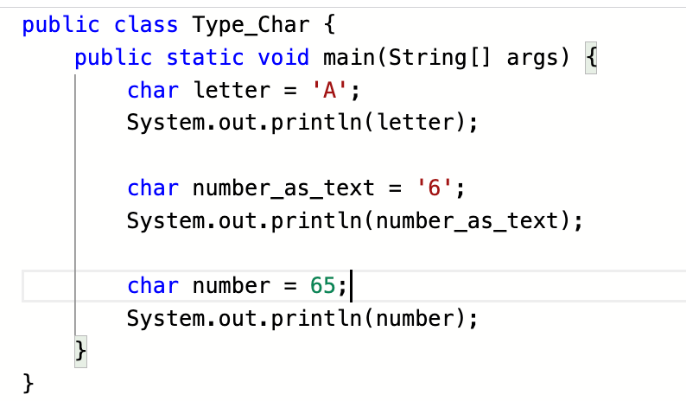
Data Types
401 Response

Slide 40
Declaring multiple variables in a single line
// Group Declarations
int age, height;
char letter, alpha;
double radium, area;
// Group initializations
int age = 10, height = 5;
double radius = 2.34, area = 4.55;
401 Response

Slide 41
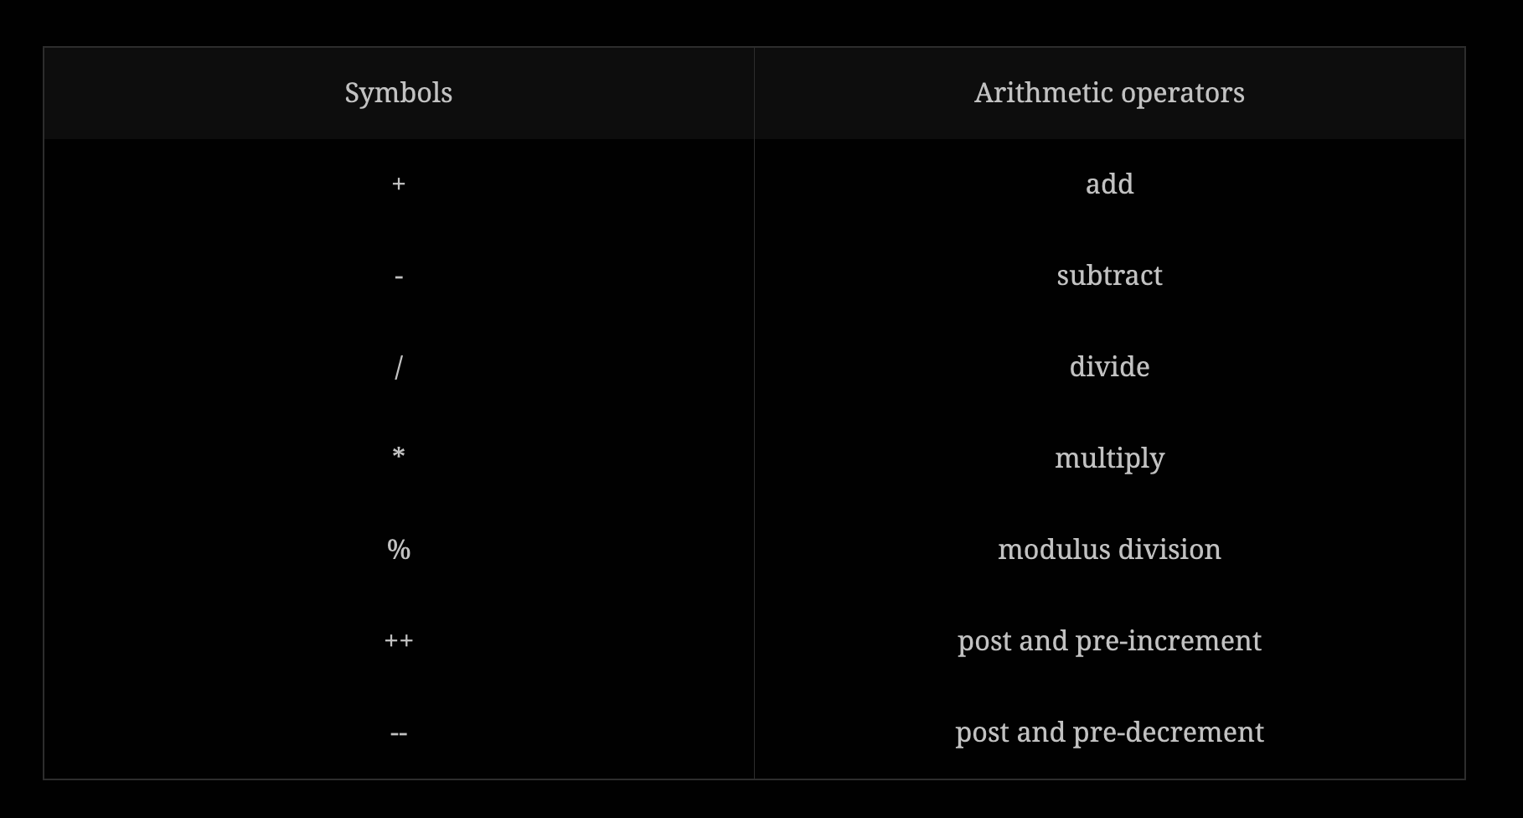
Operations in Java
401 Response

Slide 42
Operator precedence
Rule of BODMAS, which says; Brackets, Order, Division, Multiplication, Addition, and then Subtraction.
(10 - 4) + 3 *4
200 / 50 + (3 * 4)
10+3-4
401 Response

Slide 43
Java Math class
System.out.println("2 raised to the power 3 is " + Math.pow(2, 3));
System.out.println("Exponent squared is " + Math.exp(2));
System.out.println("The square root of 16 is " + Math.sqrt(16));
System.out.println("The cube root of 27 is " + Math.cbrt(27));
401 Response

Slide 44
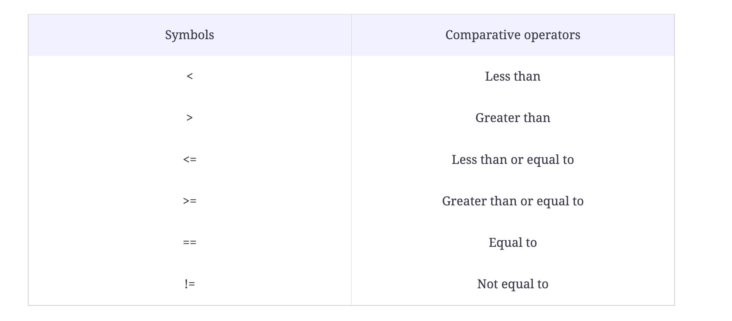
Comparative operators
401 Response

Slide 45
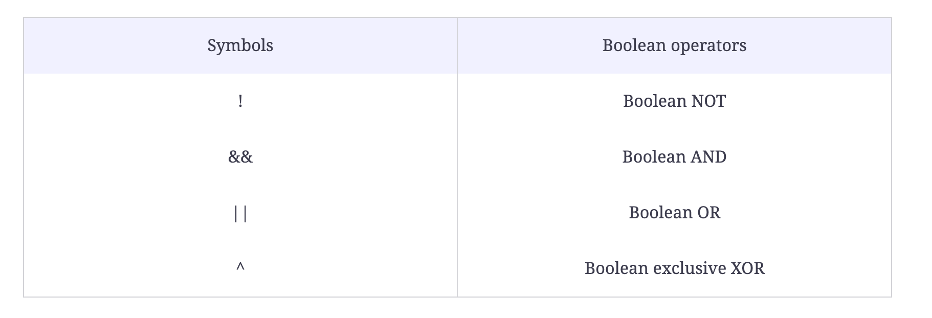
Boolean operators
401 Response

Slide 46
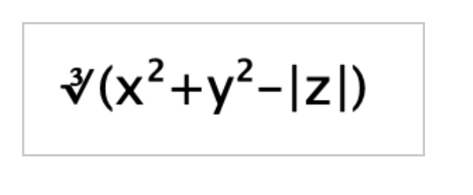
Problem Statement
401 Response

Slide 47
Problem Statement
First, compute the respective powers of two floating-point variables x and y.
Then Add them after taking powers.
Then, compute the absolute value of floating-point z.
Subtract this from the above-computed addition value.
Now take Cube Root of the answer.
Use inbuilt functions to calculate this expression
401 Response

Slide 48
Quiz
(2+3)-10 * 5;
401 Response

Slide 49
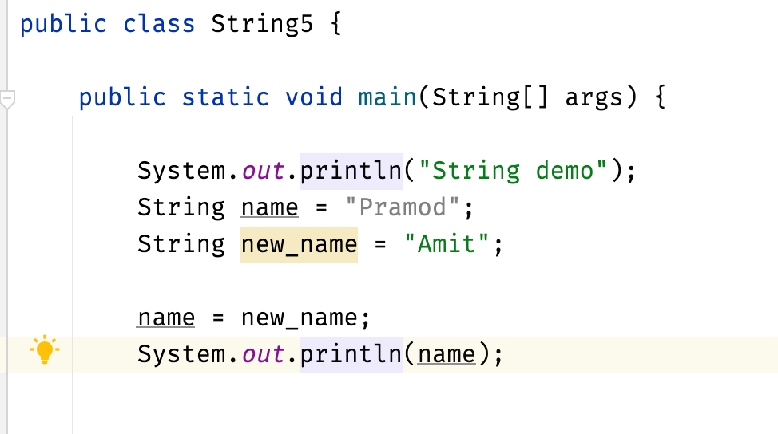
String Class
Strings are immutable non-primitive data types in Java.
Once a string is created it’s value cannot be changed
if we wish to alter its value then a new string with a new value has to be created.
401 Response

Slide 50
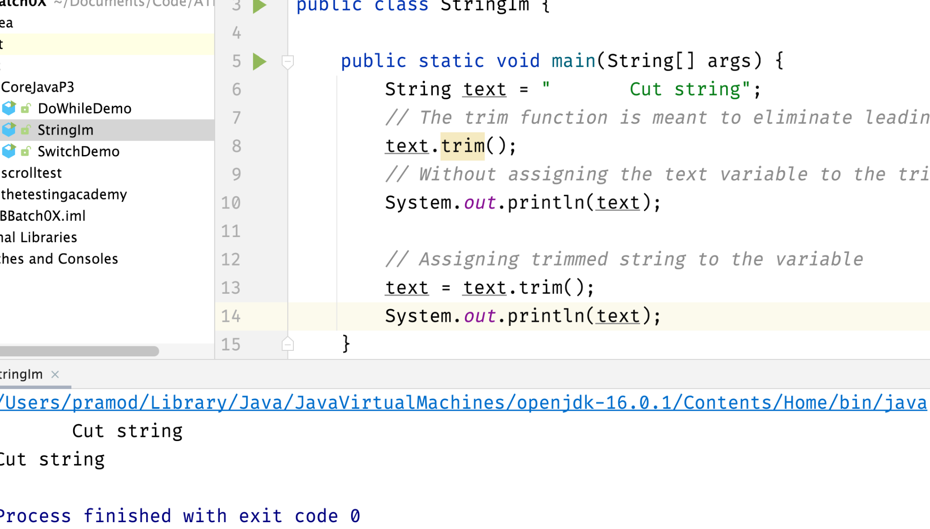
String Immutability
Keep in mind that String objects are immutable, i.e, they cannot be modified once created
401 Response

Slide 51
String Class
Concatenation
String name1 = new String("Aman");
String description = new String("is a good boy.");
String sentence = name1 + description;
System.out.println(sentence);
CharAt
String name = new String("Aman");
System.out.println(name.charAt(0));
equalsIgnoreCase
Equals Demo
Split String
Substrings
ToUpper
ToLower
401 Response

Slide 52
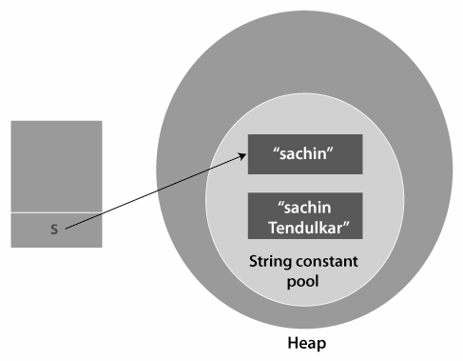
String Class
Strings are immutable non-primitive data types in Java.
New String is created
String Pool or String Constant Pool is a special area in Java Heap memory where string literals are stored
401 Response

Slide 53
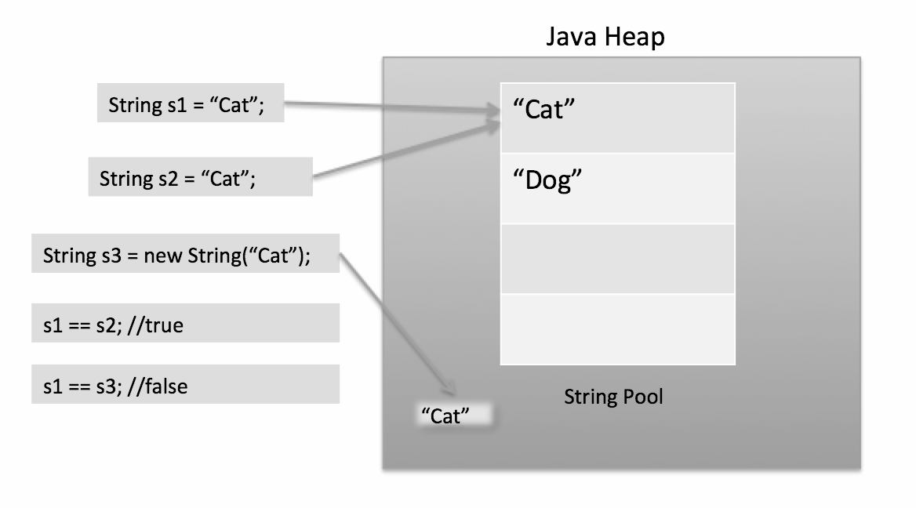
String Class
401 Response

Slide 54
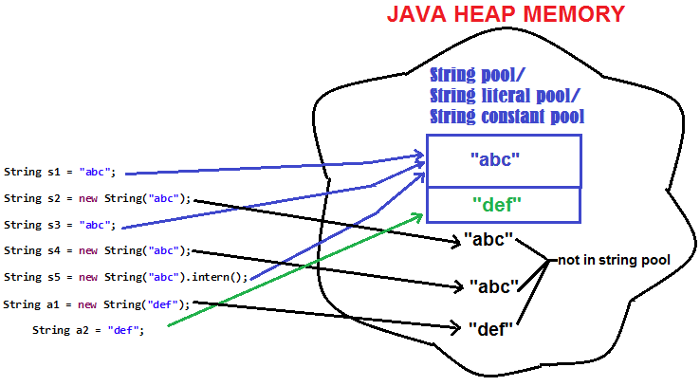
String Class
401 Response

Slide 55
String Interning is a method of storing only one copy of each distinct String Value, which must be immutable.
401 Response

Slide 56
String Class
Substring
String name = new String("AmanAndAkku");
System.out.println(name.substring(0, 4));
Length
String name = new String("Aman");
System.out.println(name.length());
Replace
String name = new String("Aman");
System.out.println(name.replace('a', 'b'));
401 Response

Slide 57
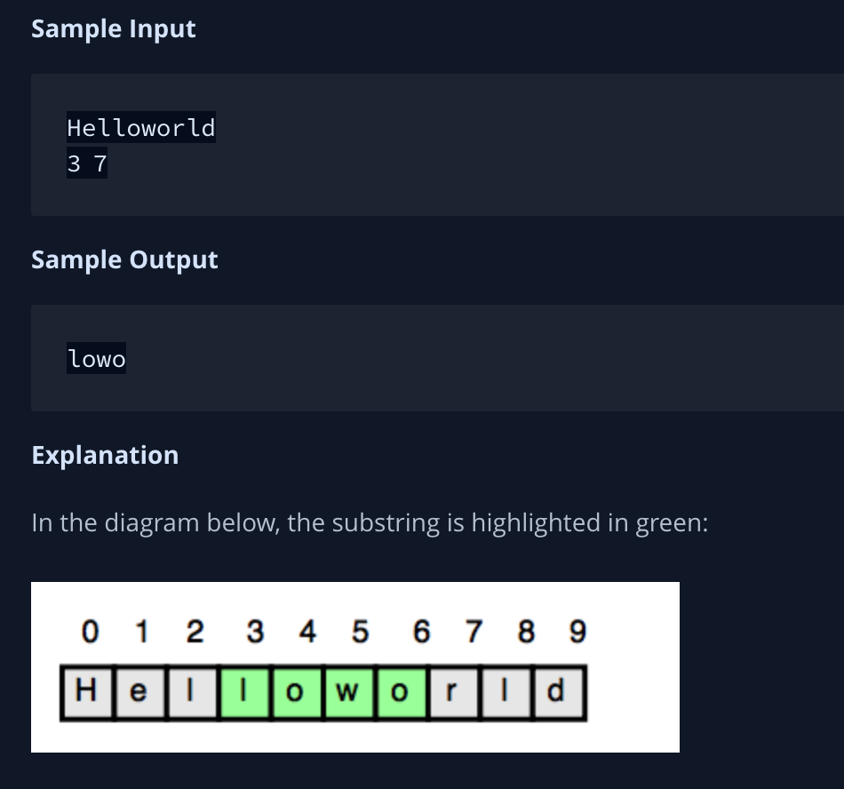
Problem String
401 Response

Slide 58
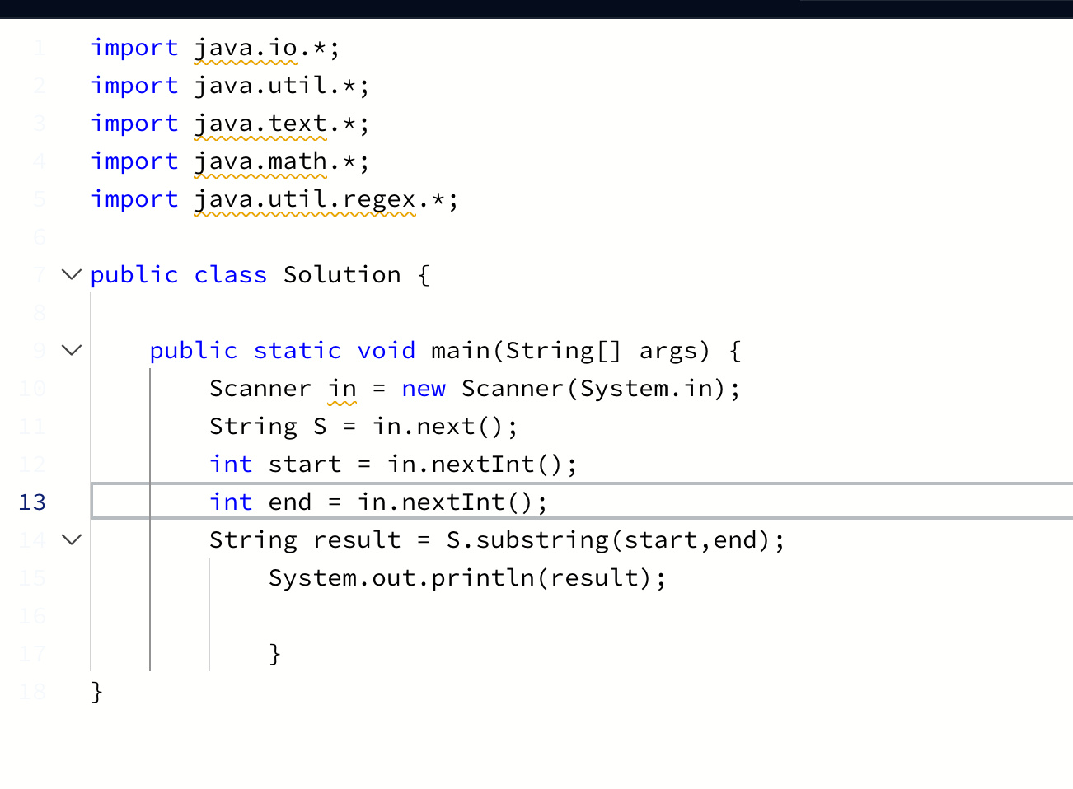
Problem String
import java.io.*;
import java.util.*;
import java.text.*;
import java.math.*;
import java.util.regex.*;
public class Solution {
public static void main(String[] args) {
Scanner in = new Scanner(System.in);
String S = in.next();
int start = in.nextInt();
int end = in.nextInt();
String result = S.substring(start,end);
System.out.println(result);
}
}
401 Response
https://www.hackerrank.com/challenges/java-substring/problem

Slide 59
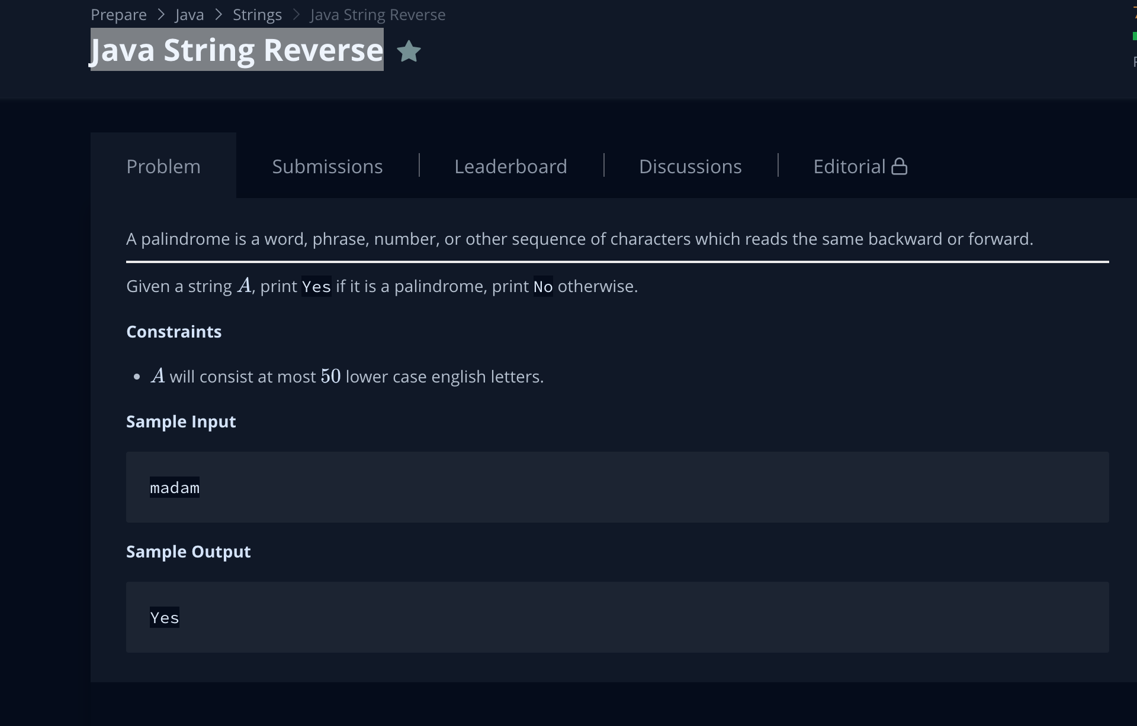
Problem String
401 Response
https://www.hackerrank.com/challenges/java-string-reverse/problem

Slide 60
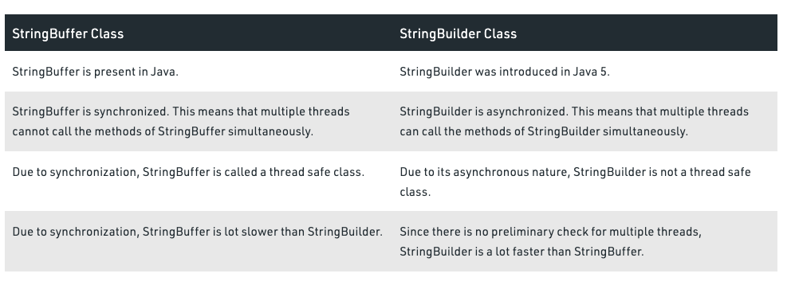
StringBuilder vs StringBuffer
401 Response

Slide 61
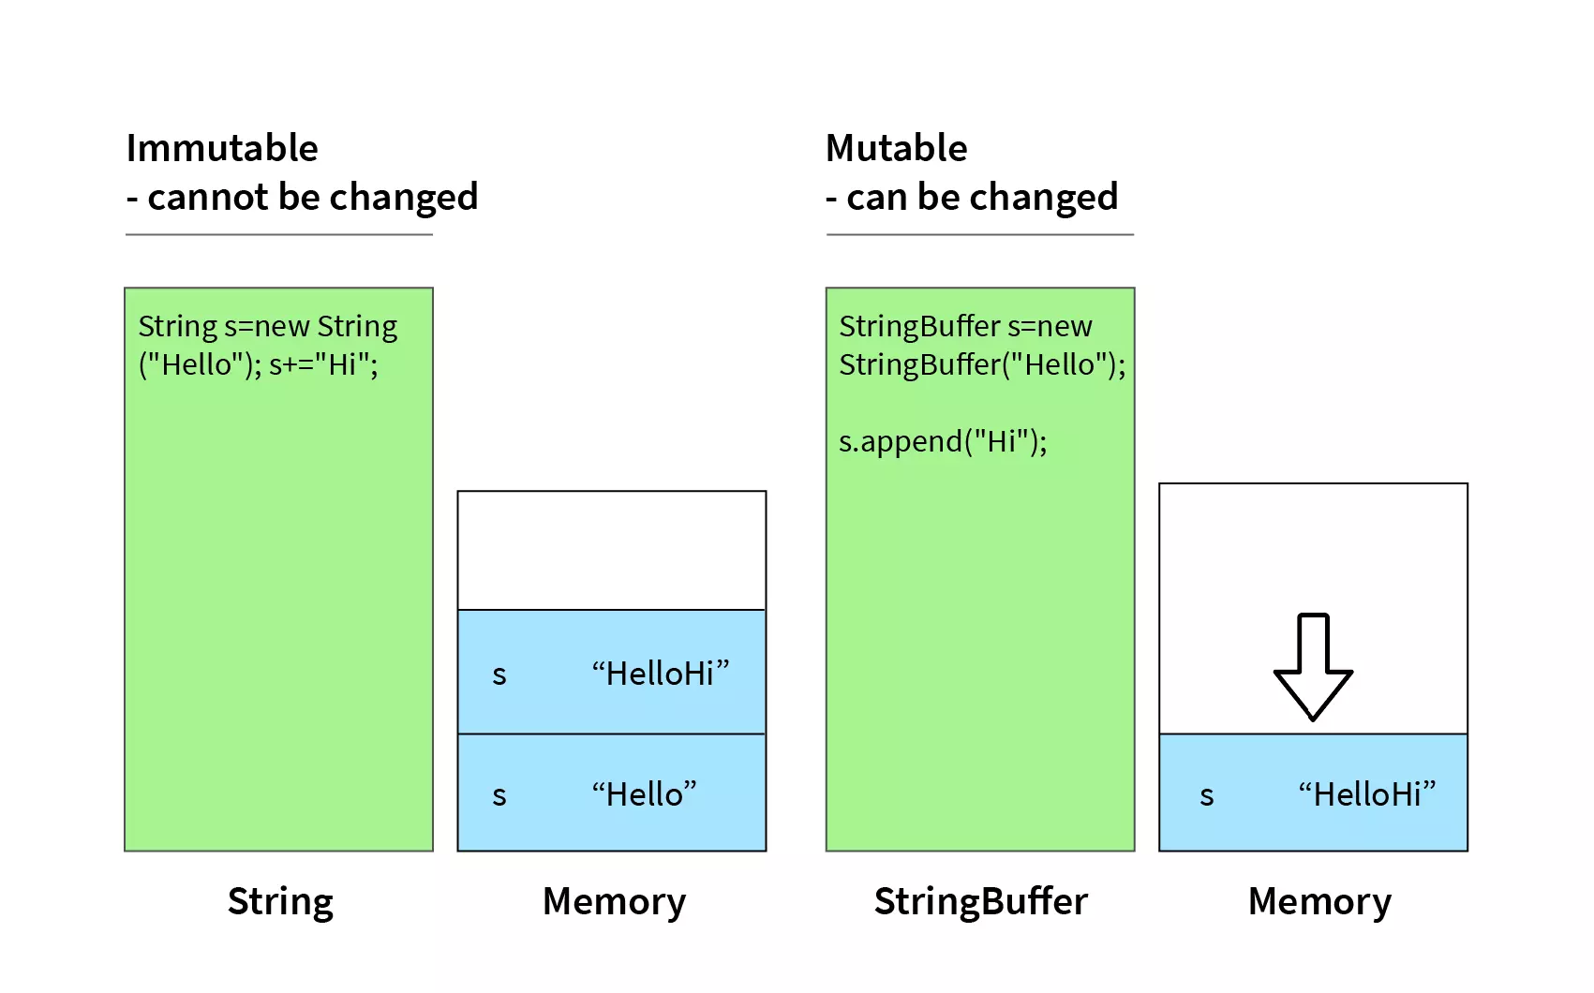
StringBuilder vs StringBuffer
401 Response

Slide 62
Casting
Casting in java is the assigning values of one type to another
we can only assign values of a number type to another type storing numbers
Implicit casting
This casting is done by java implicitly i.e. on its own. It is assigning smaller values to larger data types.
float price = 100.00F;
int gst = 18;
float finalPrice = price + gst;
Explicit casting
This casting is done by the programmer. It is assigning larger values to smaller data types.
int price = 100;
float gst = 18.00F;
int finalPrice = price + (int)gst;
401 Response

Slide 63
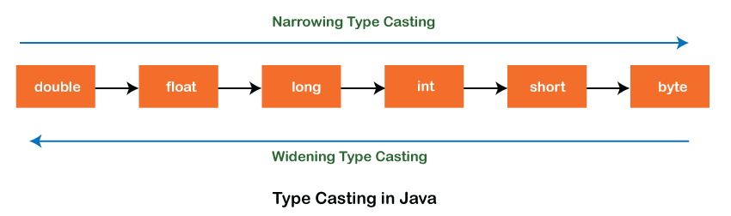
Casting : Auto widening and explicit narrowing
The data is implicitly casted from small sized primitive type to big sized primitive type. This is called auto-widening
The data is automatically casted from byte to short, short to int, int to long, long to float and float to double.
explicitly convert the data from double to float, float to long, long to int, int to short and short to byte This is called explicit narrowing.
401 Response

Slide 64
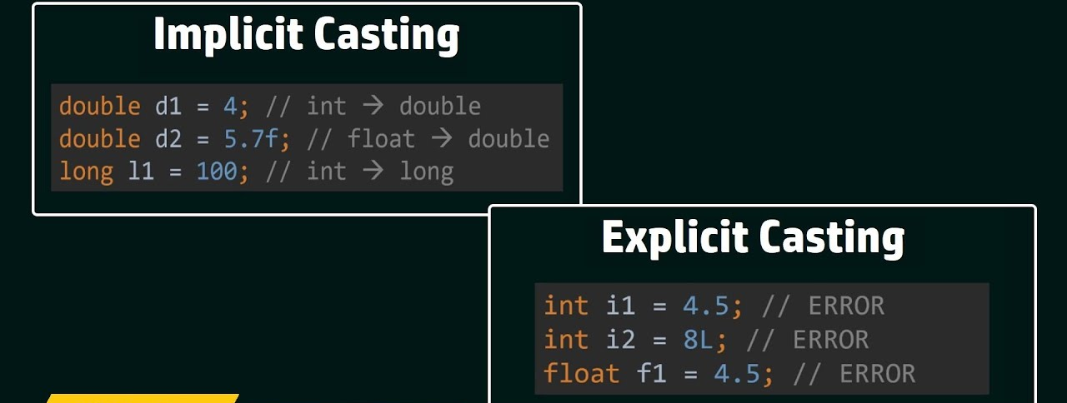
Casting : Auto widening and explicit narrowing
401 Response

Slide 65
Constants
A constant is a variable whose value cannot change once it has been assigned
final float pi = 3.14f;
401 Response

Slide 66
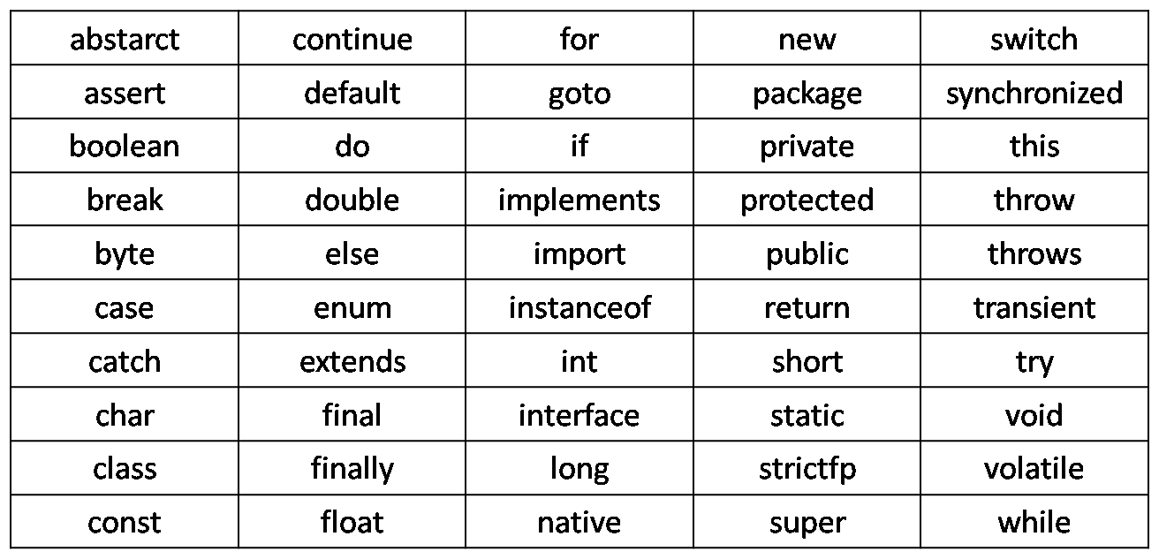
Keywords
keywords are also known as reserved words.
401 Response

Slide 67
Operators in Java
Unary Operator,
Arithmetic Operator,
Shift Operator,
Relational Operator,
Bitwise Operator,
Logical Operator,
Ternary Operator and
Assignment Operator.
401 Response

Slide 68
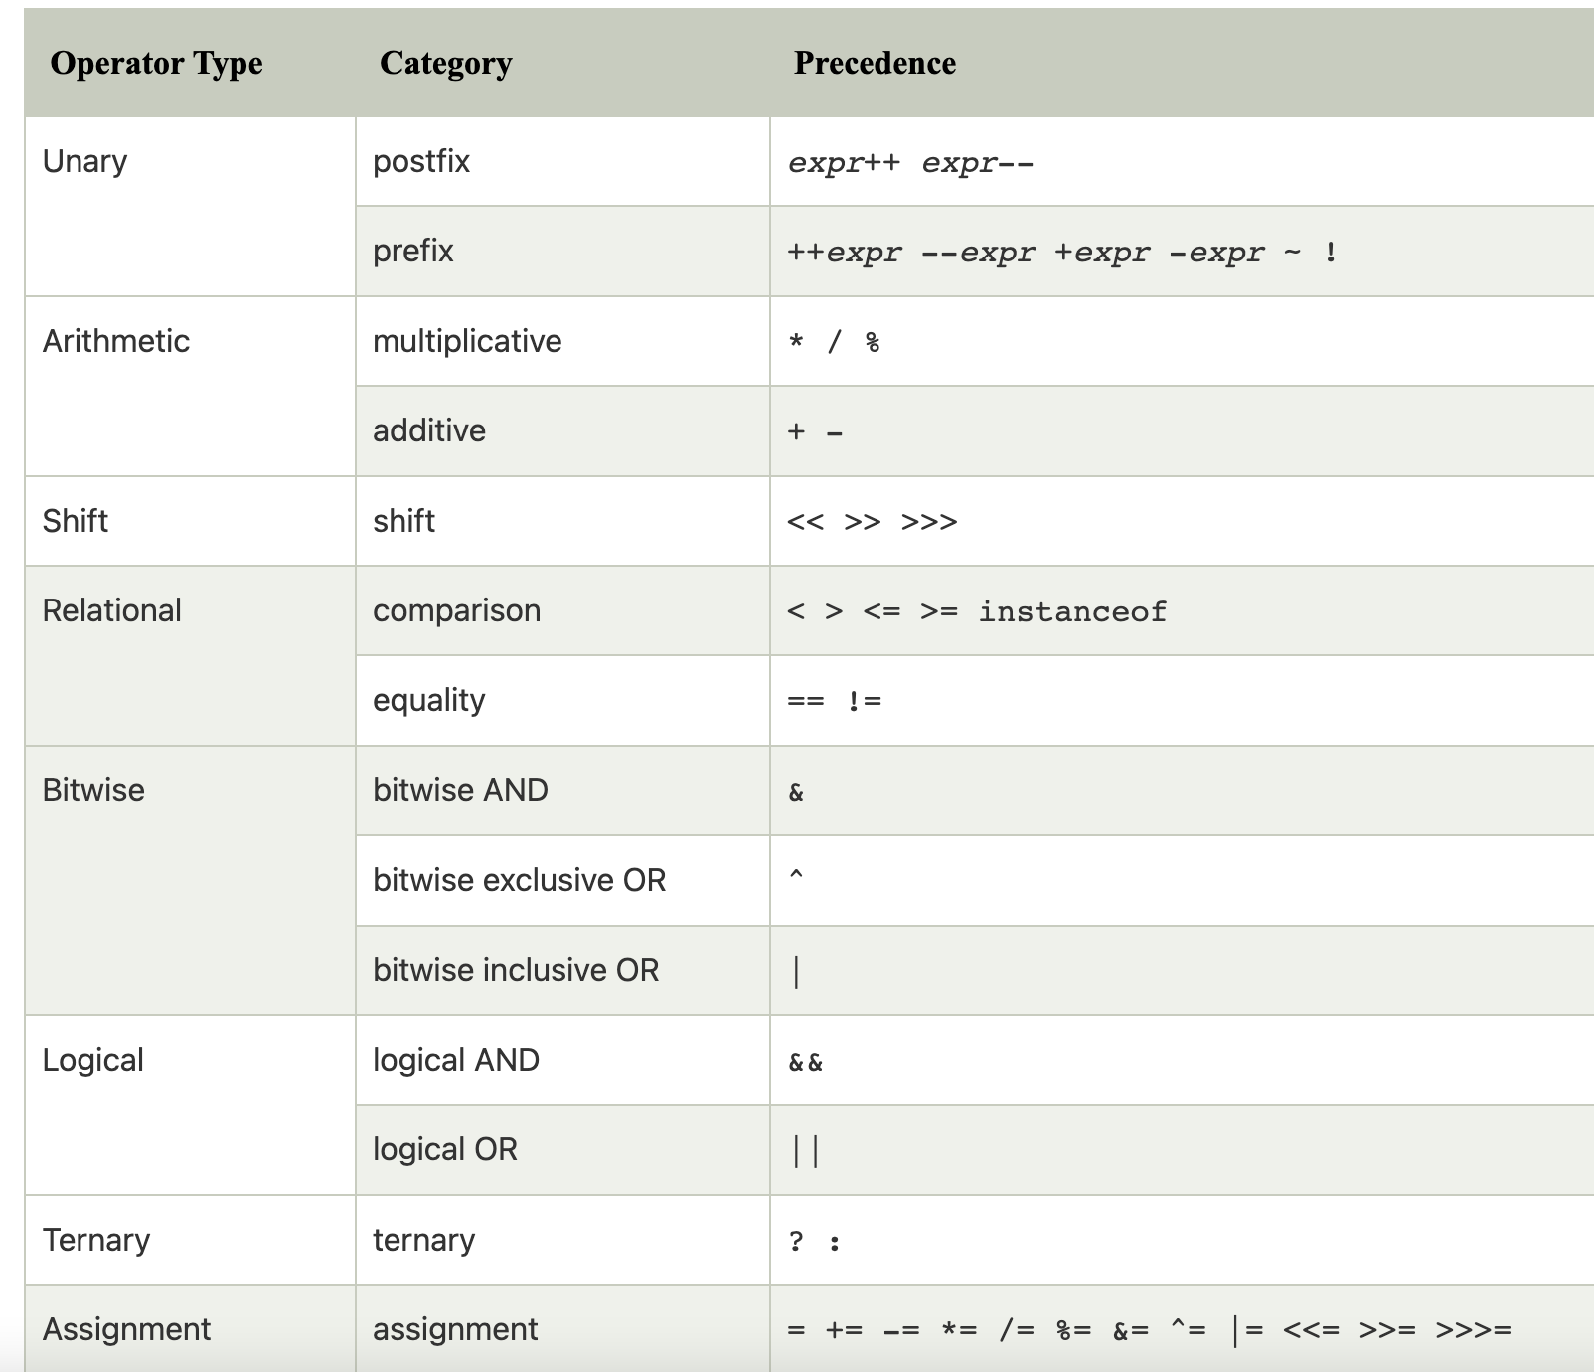
Operator Precedence
401 Response

Slide 69
Math Class
Math is an important class in Java that is extensively used and has a lot of interesting functions.
To import - import java.lang.Math;
Some functions include:
Max
int a = 10;
int b = 20;
Math.max(a, b);
Min
int a = 10;
int b = 20;
Math.min(a,b);
Random
int randomNumber = (int)(Math.random()*100);
401 Response

Slide 70
Taking Input
We take input using the Scanner class and input various types of data using it.
To import the Scanner class - import java.util.Scanner;
Example :
Scanner sc = new Scanner(System.in);
int n = sc.nextInt();
float a = sc.nextFloat();
String name = sc.next();
String line = sc.nextLine();
401 Response

Slide 71
Conditional Statements ifelse
if(boolean) {
//Code
} else {
//Code
}
401 Response

Slide 72
Conditional Statements ifelse
int age = 30;
if(age > 18) {
System.out.println("This is an adult");
} else {
System.out.println("This is not an adult");
}
401 Response

Slide 73
Coding Exercise
Coding exercise#
Given a number x, you should check whether it is even or odd.
If it is even, then store "even" in answer.
If it is odd, then store "odd" in answer.
401 Response

Slide 74
Coding Exercise
String answer;
if (x % 2 == 0) {
answer = "even";
} else {
answer = "odd";
}
return answer;
401 Response

Slide 75
Conditional Statements Switch
switch(expression) {
case x:
// code block
break;
case y:
// code block
break;
default:
// code block
}
401 Response

Slide 76
While Loop
int i = 0;
while (i < 5) {
System.out.println(i);
i++;
}
401 Response

Slide 77
Do While Loop
do-while loop is used to iterate a part of the program repeatedly, until the specified condition is true. do-while loop is called an exit control loop.
do{
//code to be executed / loop body
//update statement
}while (condition);
401 Response

Slide 78
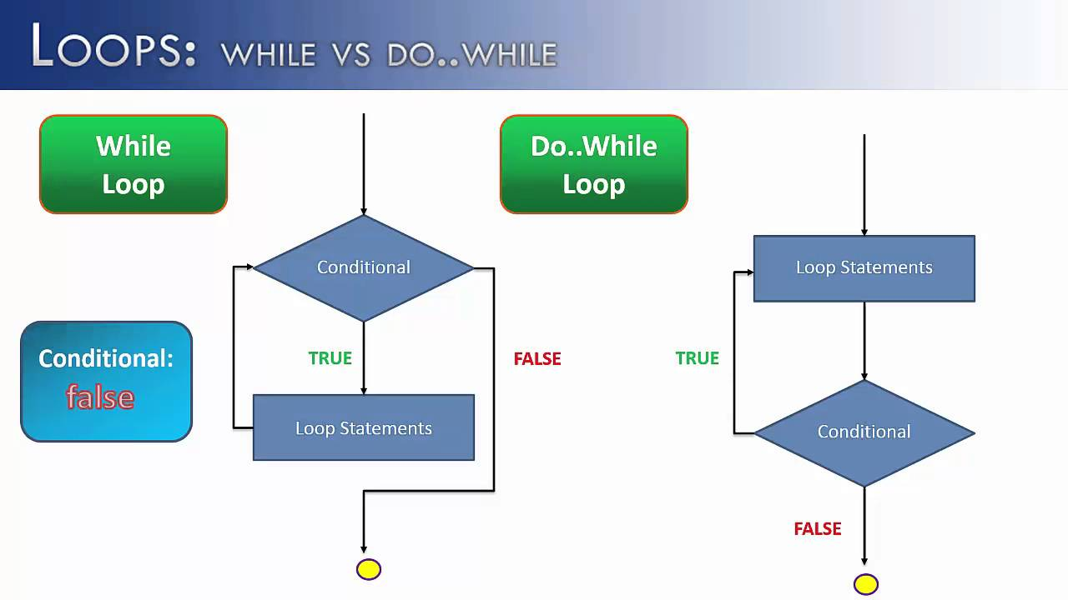

Slide 79
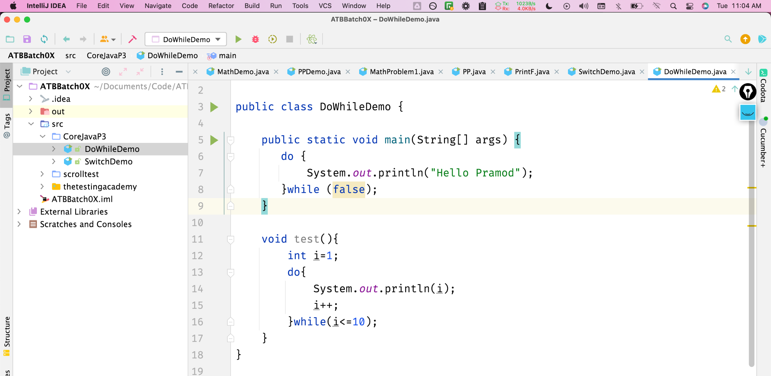

Slide 80
For LOOP
for (int i = 0; i <= 10; i = i + 2) {
System.out.println(i);
}
401 Response

Slide 81
For Each Loop
String[] cars = {"Volvo", "BMW", "Ford", "Mazda"};
for (String i : cars) {
System.out.println(i);
}
401 Response

Slide 82
Break & Continue
for (int i = 0; i < 10; i++) {
if (i == 4) {
break;
}
System.out.println(i);
}
401 Response

Slide 83
Break & Continue
for (int i = 0; i < 10; i++) {
if (i == 4) {
continue;
}
System.out.println(i);
}
401 Response

Slide 84
Conditional Statements ifelse
Problem https://www.hackerrank.com/challenges/java-if-else/problem
401 Response

Slide 85
Conditional Statements ifelse
import java.io.*;
import java.math.*;
import java.security.*;
import java.text.*;
import java.util.*;
import java.util.concurrent.*;
import java.util.regex.*;
public class Solution {
private static final Scanner scanner = new Scanner(System.in);
public static void main(String[] args) {
int N = scanner.nextInt();
scanner.skip("(\r\n|[\n\r\u2028\u2029\u0085])?");
if(N%2!=0){
System.out.println("Weird");
}else{
if(N >= 2 && N <= 5){
System.out.println("Not Weird");
}
if(N >= 6 && N <= 20){
System.out.println("Weird");
}
if(N > 20){
System.out.println("Not Weird");
}
}
scanner.close();
}
}
Solution
401 Response

Slide 86
Arrays
Like a list of elements of the same type i.e. a list of integers,
Creating an Array (method 1) - with new keyword
int[] marks = new int[3];
marks[0] = 97;
marks[1] = 98;
marks[2] = 95;
Creating an Array (method 2)
int[] marks = {98, 97, 95};
401 Response

Slide 87
Problem Max in Array
Max in ARRAY
Sample input & output #
Input: {4, 10, 12, 17, 11}
Output: 17
401 Response

Slide 88
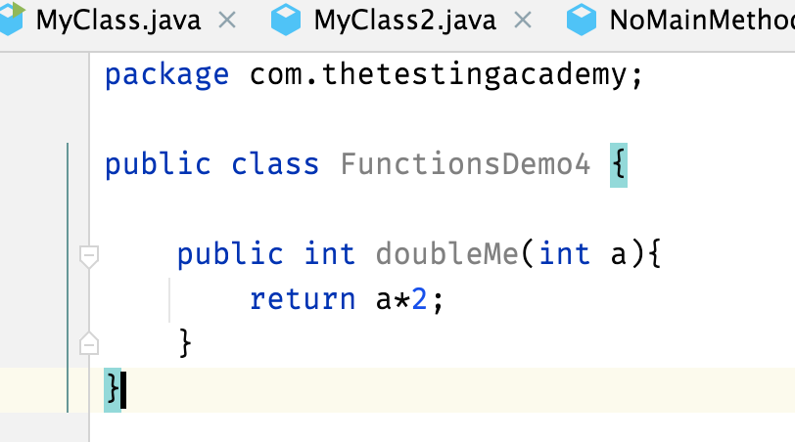
Functions / Methods
A function is a block of code which takes some input, performs some operations and returns some output.
The functions stored inside classes are called methods.
The function we have used is called main.
401 Response

Slide 89
Problem statement
Write a static method checkSum that adds two integer arguments and returns 0, 1 or 2.
Takes two integers one and two in its input. Arguments are pass by value to the method.
Has a check variable whose value gets updated as explained below.
Adds num1 and num2, and checks if their sum is less than 100 in which case
Sets the value of the check variable to 0.
If sum is greater than 100
Sets the value of the check variable to 1.
If sum is equal to 100
Sets the value of the check variable to 2.
In the end, it will return the check variable.

Slide 90
public static int checkSum(int one, int two) {
//Write your code here
//Declare the necessary variable
int check;
int sum = one + two;
if (sum < 100) {
check = 0;
} else if (sum > 100) {
check = 1;
} else {
check = 2;
}
//Change the return variable as well
return check;
}
}

Slide 91
Problem
Sample input#
var = 3557
Sample output#
sum = 3 + 5 + 5 + 7 = 20

Slide 92
Problems
Todo
problem of sum
max array
Function with return check variable
401 Response

Slide 93
package CoreJavaP3.Loops;
public class SumOfDigit {
public static void main(String[] args) {
int input = 3453;
int sum= 0;
while(input > 0){
sum = sum + input%10;
input = input/10;
}
System.out.println(sum);
}
}

Slide 94
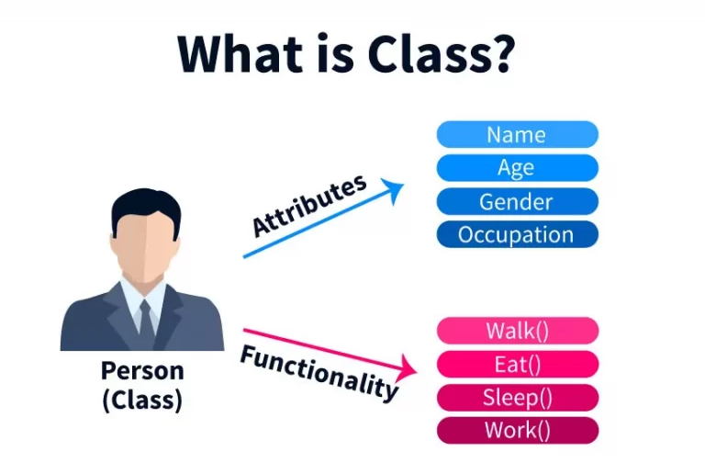
Class
A class is a group of objects which have common properties. A class can have some properties and functions (called methods).
The class we have used is Main.
401 Response
When a class is created, no memory is allocated

Slide 95
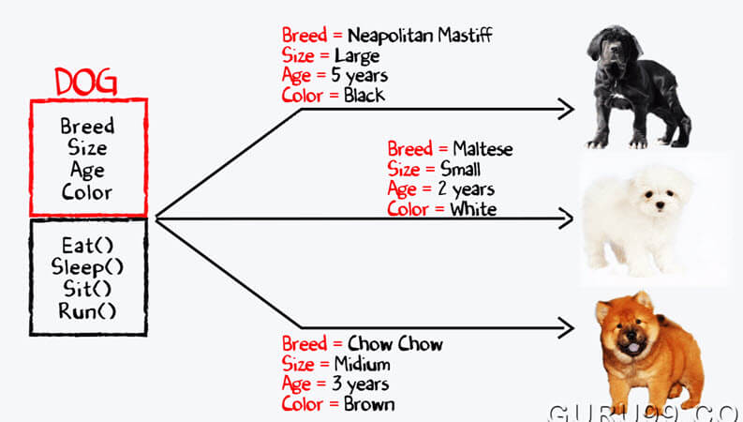
Objects
Object is an instance of a class. All data members and member functions of the class can be accessed with the help of objects
401 Response
Objects are allocated memory space whenever they are created.

Slide 96
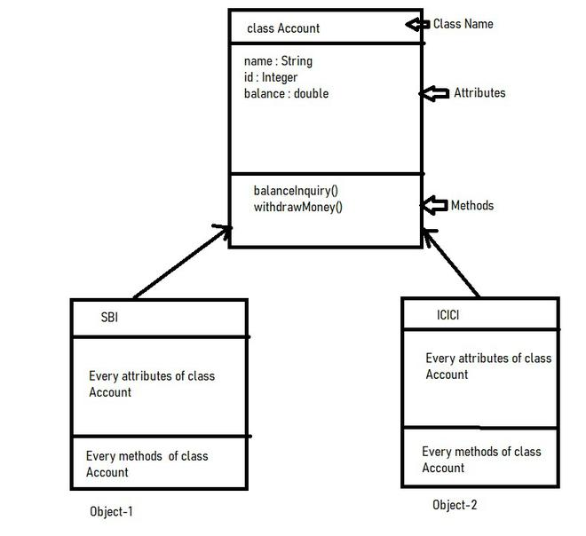
Class & Objects
401 Response

Slide 97
Class
Every class in Java can be composed of the following elements:
fields, member variables or instance variables - These are variables that hold data specific to a particular object. For each object of a class, there is one field.
member methods or instance methods - These perform operations on objects and are defined within the class.
static or class fields - These fields are common to any object within the same class. They can only exist once in the class irrespective of the total number of objects in the class.
static or class methods - These methods do not affect a specific object in the class.
inner classes - At times a class will be defined within a class if it is a subset of another class. The class contained within another is the inner class.
401 Response

Slide 98
What is your Biggest takeaway from this...

Slide 99
Action Item Block at least
5-7 hour per Weekend.

Slide 100
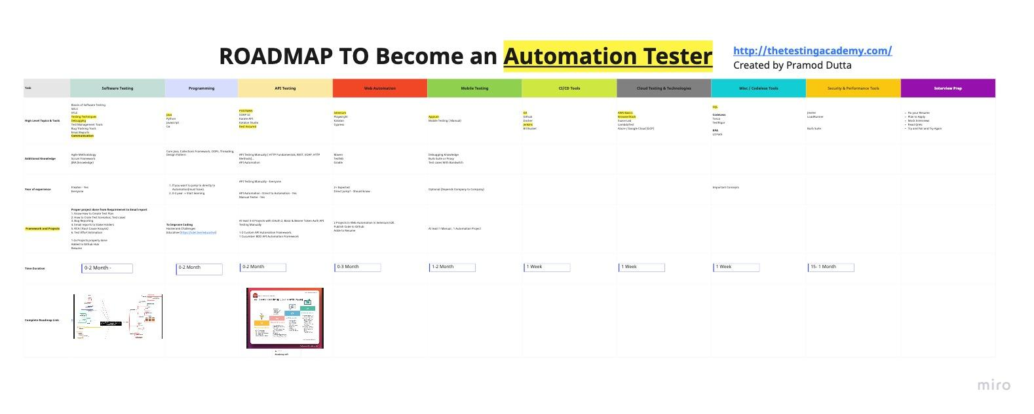
ROADMAP
https://sdet.live/roadmap-automation

Slide 101
Topics
https://sdet.live/topics

Slide 102
Course Details….

Slide 103

ROADMAP - 4 Months

Slide 104
Core java
OOPs Concepts
Collection Framework
Threading
Design Patterns

Slide 105

Core Java

Slide 106

Collection Framework

Slide 107


Slide 108

Threading

Slide 109

HackerRank

Slide 110

Educative https://sdet.live/educative

Slide 111
Project Overview!!

Slide 112




Manual Testing Projects

Slide 113






API Testing Projects

Slide 114


Web Automation Projects

Slide 115


Slide 116

Roadmap to learn Selenium

Slide 117
Web Automation Selenium Real World Projects

Slide 118
Key features of Web Automation Framework used
Key features of Web Automation Framework used :
Page Object Model (POM)
Java : most convenient programming language.
Maven: For build management purpose, a common structure can be maintained very easily
TestNG: Open source, most used Testing Framework, Amazing annotations
Allure Reports : As it is most clean automation reports and provides lots of useful annotations as well. For better documentation, it has been chosen over other reporting tools
Lombok plugin : It provides very simple logging framework as compared to other logging methods
Selenium Grid Handling
Parallel Execution with Groupings
Supports Cloud Testing Services like BrowserStack, SauceLabs.

Slide 119
Web Automation - Selenium
Grouping.
Parallel Execution.
Running on Grid.
Reports.
Config Properties.

Slide 120


Slide 121


Slide 122


Slide 123

Playwright Self Added(Pom)
Key features of Web Automation Framework used :
Page Object Model (POM)
Java : most convenient programming language.
Maven: For build management purpose, a common structure can be maintained very easily
TestNG: Open source, most used Testing Framework, Amazing annotations
Allure Reports : As it is most clean automation reports and provides lots of useful annotations as well. For better documentation, it has been chosen over other reporting tools
Parallel Execution with Groupings
Supports Cloud Testing Services like BrowserStack, SauceLabs.

Slide 124

API Testing Projects Manual + Automation

Slide 125
Manually Testing the APIs
End to End Life Cycle of STLC from Req. to Test EXECUTION
LIVE Manually Testing an APIs
4x Examples of Real World Projects
Quizz AND Interview Prep

Slide 126
Key features of API Automation Framework used
Key features of REST API Automation Framework used : (Supports SOAP(xml) also)
Cucumber BDD
Java : most convenient programming language.
Maven: For build management purpose, a common structure can be maintained very easily
TestNG: Open source, most used Testing Framework, Amazing annotations
Allure Reports : As it is most clean automation reports and provides lots of useful annotations as well. For better documentation, it has been chosen over other reporting tools
Lombok plugin : It provides very simple logging framework as compared to other logging methods
HTTP Methods Wrappers available.
Support to GraphQL (in future)
JSON Payload easy support.

Slide 127


Slide 128


Cucumber BDD + Rest Assured

Slide 129


CI/CD

Slide 130


TheTestingAcademy Mobile Automation Framework

Slide 131

Resume Building
Creating a Resume that works
Help in Job finding and research
LinkedIn methods to research jobs for Automation Tester
Tips and Tricks to get more HR Call

Slide 132



Written Notes, (Recordings 24x7)

Slide 133
Access to 24x7 LMS
Quiz
Assignments

Slide 134

Doubt Session & Group Discussion

Slide 135

Curated Jobs, Passing Resume to HRs
Updated Curated Jobs Share
Reference of Alumni if possible
Circulating Resumes within peers
References

Slide 136




Mock Interview Prep
Discussion on How to Crack QA Interview
How to Prepare for Interview ?
Tips and Tricks which helped me to crack QA Interview
Things you should avoid in QA Interview

Slide 137

Certificate of Completion!!

Slide 138



TOTAL VALUE
~92,000
4 Month - LIVE Course - Rs 45,000
5+ Bonus (Manual Course + API Testing Course) - Rs - 15,000
SDET Club Access Lifetime. - Rs - 5,999

Slide 139

Special Class Coupon Discount: PROMODE
https://sdet.live/become

Slide 140

Price Rs 9999
LIVE Class
1 Month - LIVE Course
Access to Previous Batch
Playwright with Java Course.
5+ Bonus (Manual Course + API Testing Course)
SDET Club Access Lifetime.
java
https://sdet.live/java30days

Slide 141



Testimonials

Slide 142


BONUS - Playwright with Java for Web Automation Testing + API Testing(+UI)
Rs 5,999, Self PACED
Will be Release on APR End.

Slide 143
World it be worth it?
Get into a Single course Teaching you
Manual + API + Web Automation
Give you access to SDET.club with 4500+ QA?
Lifetime Access and Masterclasses weekly
Learn from a person 12+ Year Cracked Multiple companies

Slide 144

Important

Slide 145

EMI

Slide 146

Important

Slide 147
Testimonials

Slide 148
How can I help?
https://sdet.live/connect

Slide 149
How can I help?
https://sdet.live/become
Special Class Discount: PROMODE
https://sdet.live/become
https://sdet.live/WhatsApp

Slide 150
Thanks, for attending Class
I hope you liked it. Say Thanks in Comment :)

